Slide 1
For an end-to-end Lending digitalization

Slide 2
methodology to manage Data science projects
Decision Model Pipeline
Train model
Visualize
Resampling
Model Tuning
Missing Data
Feature Engineering
Split Data
Model Combining
Outliers
Feature Selection
Integration
Explore
Model Benchmarking
Test stability
Monitoring
Extract
Data
Extraction
Exploratory Data analysis
Data
Cleansing
Data
Preprocessing
Modeling and Evaluation
Validation
Integration and adjustment
Data Analysis

Slide 3
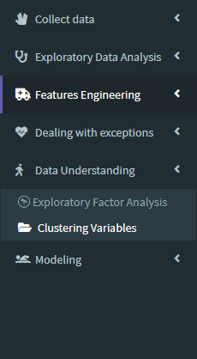
Automated process for ScoreCard modeling
Our framework carries a data analyst from the earliest steps of a data science project to its ultimate goal.
The framework supports automated jobs labeled within major process phases.
New functionalities are continuously implemented and improved such that it helps with data wrangling, data cleaning, data visualization and modeling.
The framework considers splitting functionalities into modular use so that each output can feed other steps (can be iterative processing or one direction progress)

Slide 4
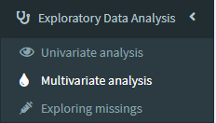
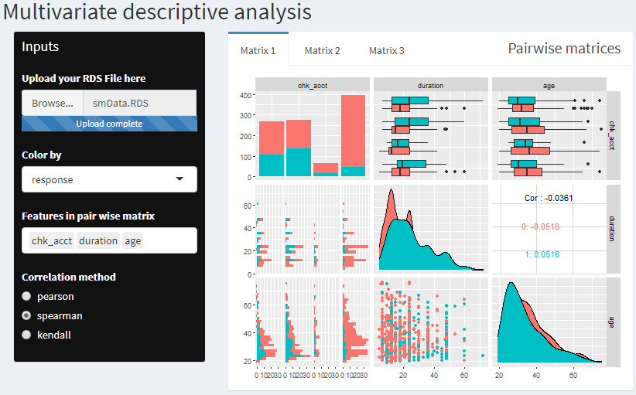
Automated process for ScoreCard modeling

Slide 5
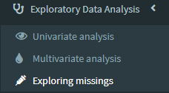
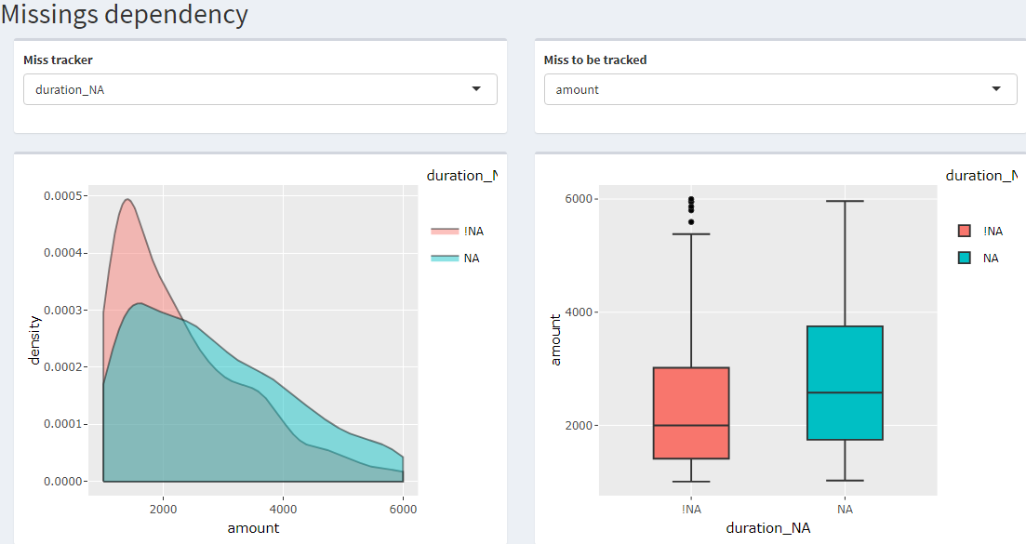
Automated process for ScoreCard modeling

Slide 6
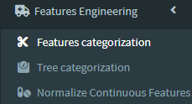
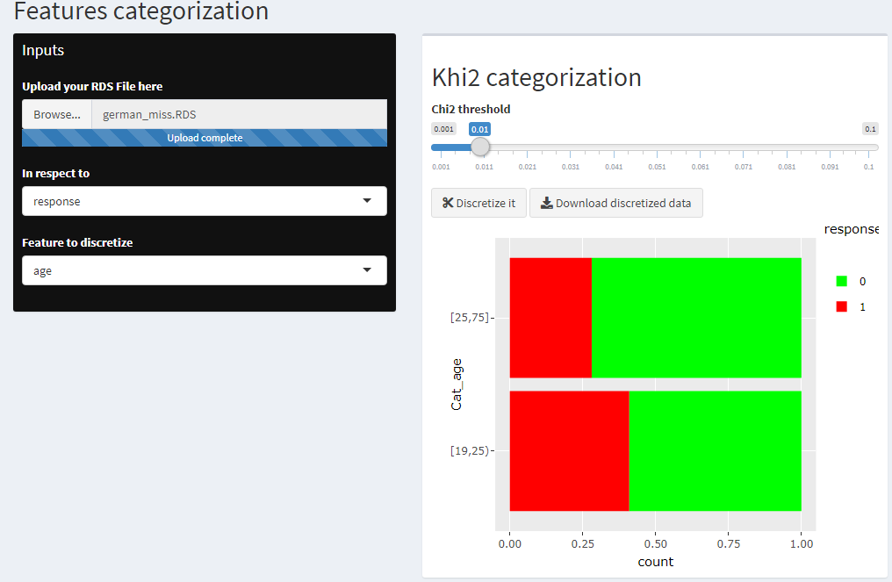
Automated process for ScoreCard modeling

Slide 7
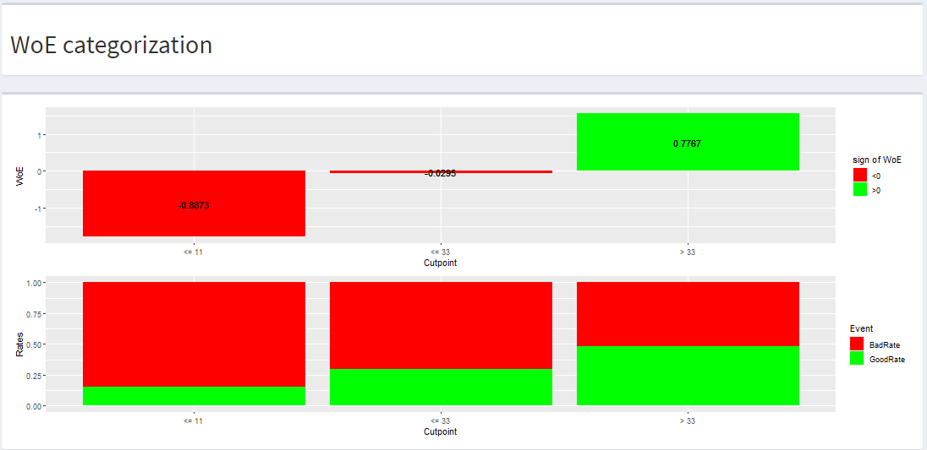
Automated process for ScoreCard modeling

Slide 8
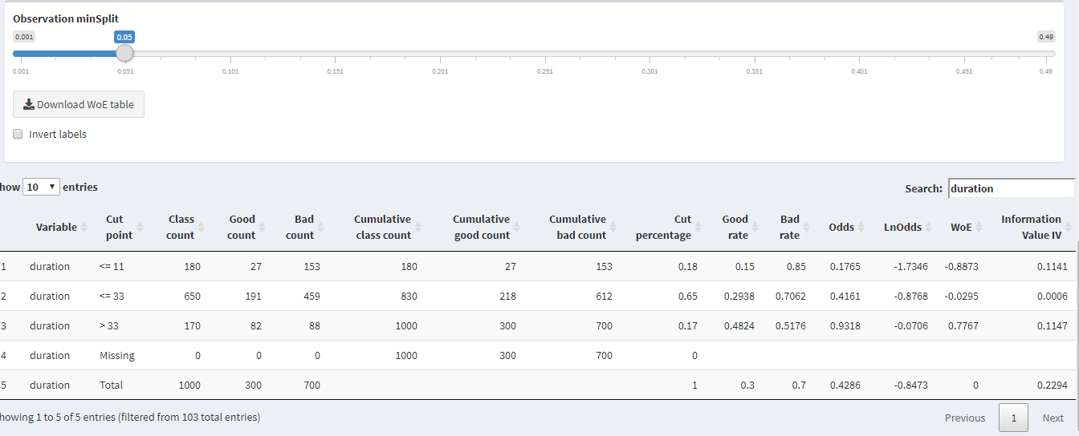
Automated process for ScoreCard modeling

Slide 9
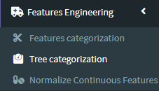
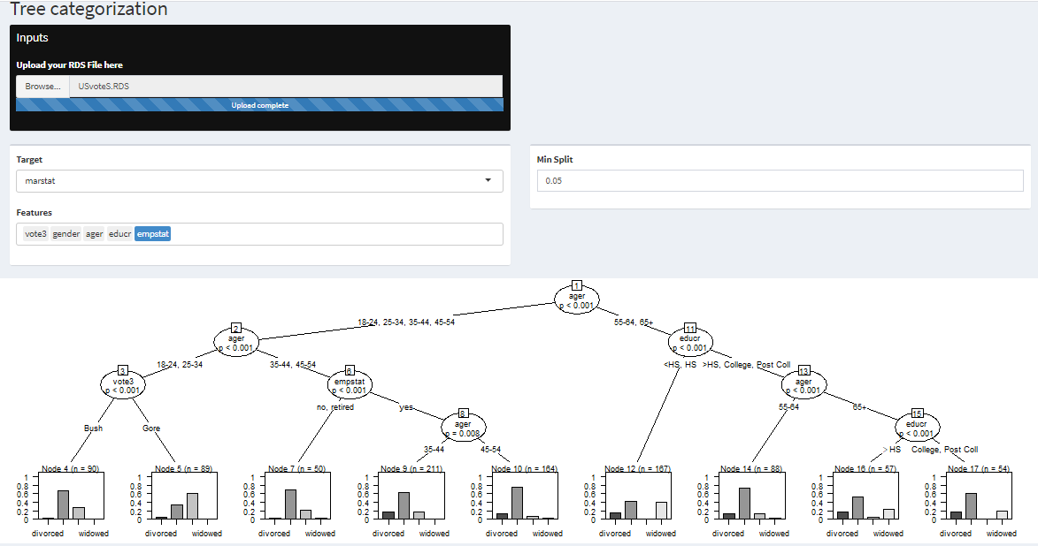
Automated process for ScoreCard modeling

Slide 10
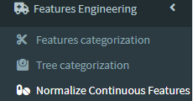
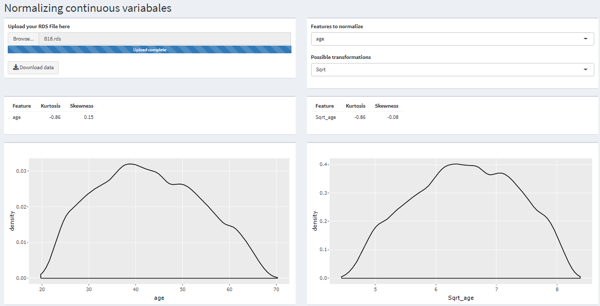
Automated process for ScoreCard modeling

Slide 11
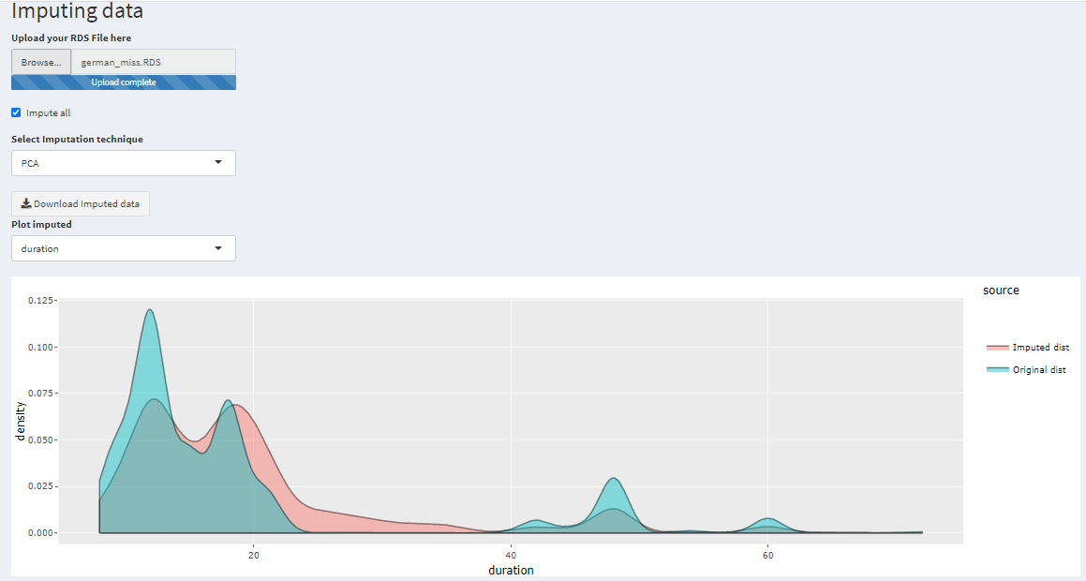
Automated process for ScoreCard modeling

Slide 12
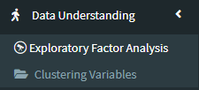
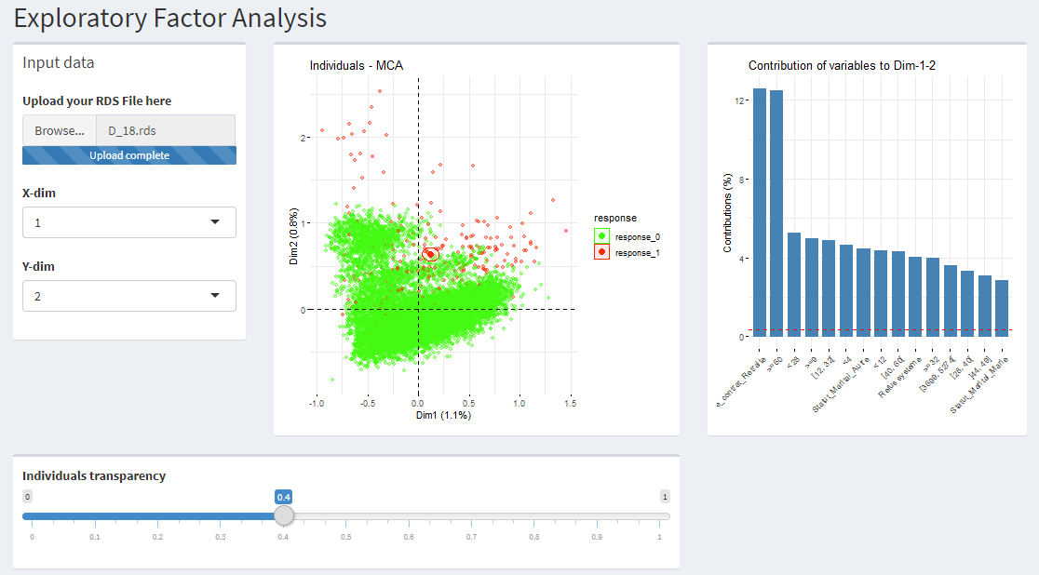
Automated process for ScoreCard modeling

Slide 13
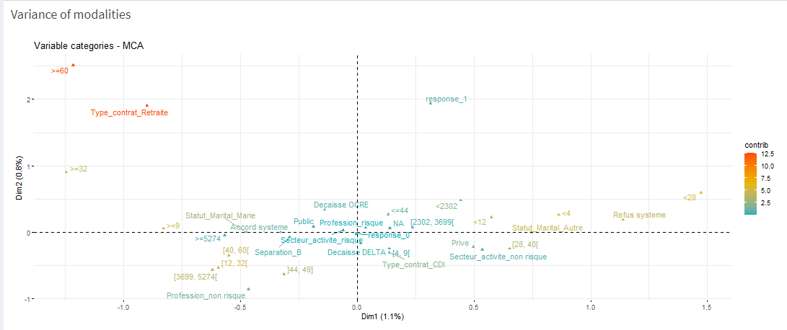
Automated process for ScoreCard modeling

Slide 14
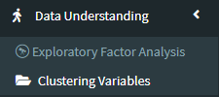
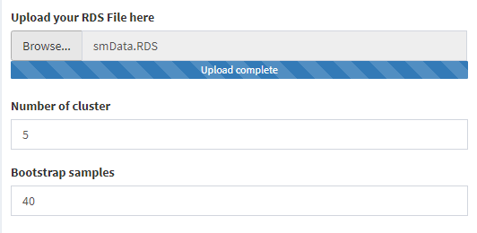
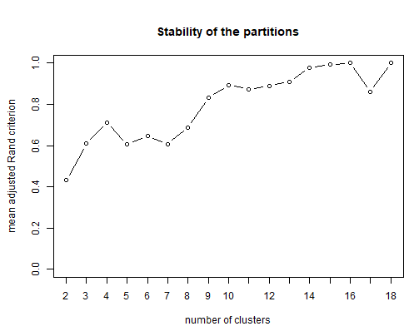
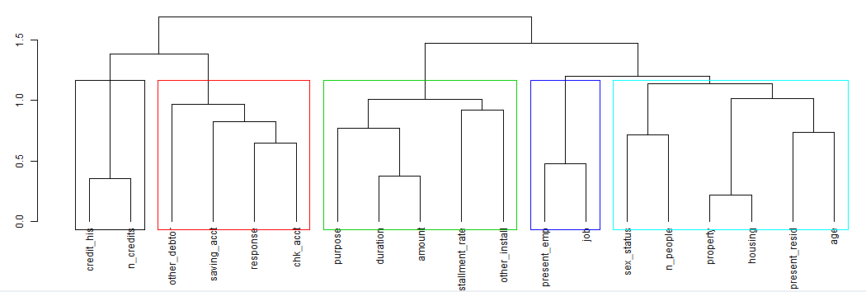
Automated process for ScoreCard modeling

Slide 15

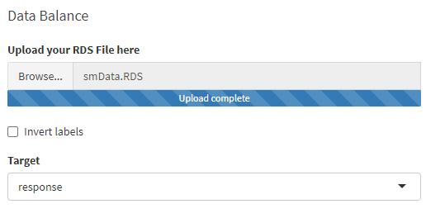
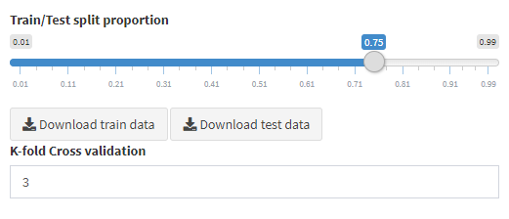
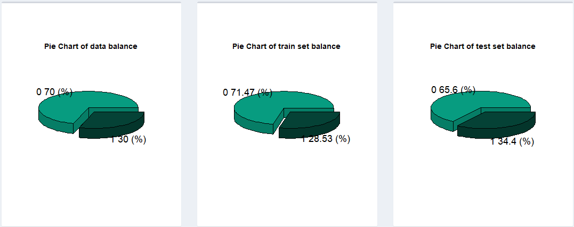
Automated process for ScoreCard modeling

Slide 16
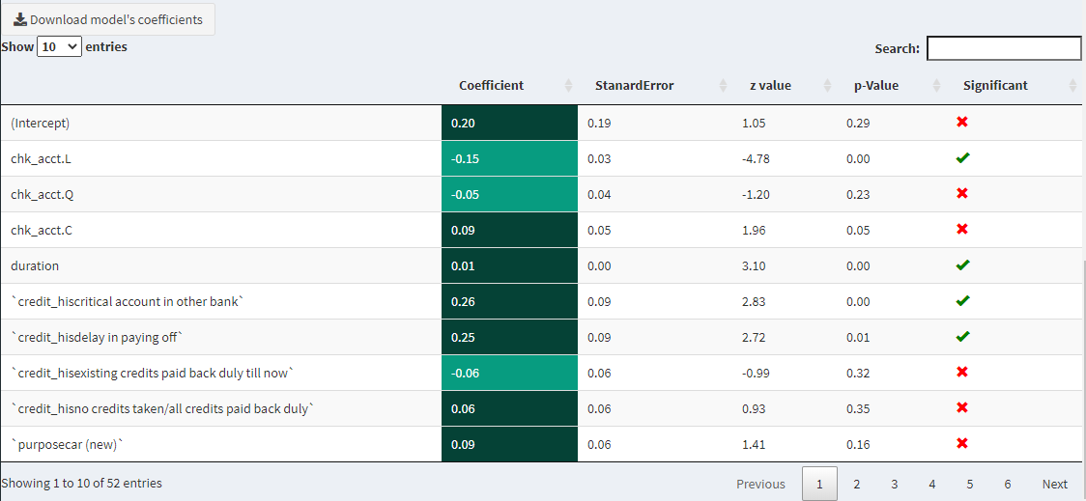
Automated process for ScoreCard modeling

Slide 17


…We were looking for a long-term provider to help us in a restructuring project which aimed to bring consistency to our Credit Policy throughout our international network and to align subsidiaries to the approach used at our model bank. Flexibility was a major determinant, indeed, axefinance solutions allow us to adjust with any market or regulatory changes we encounter, aligning ACP to our needs at no extra cost and with absolute autonomy. In addition, the implementation strategy proposed by axefinance was quite persuasive…
They Trust axefinance and say it best
«
«
GHISALBERTI Claude
Head of Credit Acceptance Solutions

Slide 18
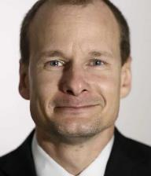

…Since our first meeting, axefinance has been a solution-oriented provider capable of meeting DID's specific needs.
We have had excellent collaboration throughout and axefinance's teams have shown the innovation and openness needed to satisfy DID's high expectations.
The Client Evolution & Services team of axefinance is clearly a big asset given the quality support they offer…
They Trust axefinance and say it best
«
«
Martin Villemure
Director EFC Network Development & Deployment

Slide 19
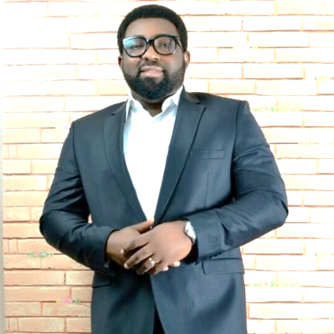

They Trust axefinance and say it best
«
Polaris Bank (ex Skye Bank plc.) prides itself on being one of the pioneers in Nigeria and the region in the adoption of innovative financial technologies that will benefit both our team and our customers. It was crystal clear for us that axefinance is a technically sound partner offering a powerful credit automation solution fitting our needs of performance optimization, credit risk mitigation and gain of efficiency. Indeed, the project was completed on time and on budget.
«
Olawoyin Babajide Alabi
Acting Deputy Chief Credit Officer / ACP implementation Team Lead

Slide 20

They Trust axefinance and say it best
«
«
Since ACP’s implementation, we’ve noticed a clear improvement in the corporate lending performance. ACP Integrates a robust and flexible workflow engine allowing design and storage of risk rating/scoring templates and their modification at anytime with complete self-sufficiency. ACP also allows us to easily compute and complete financial ratios analysis…
Corporate and Commercial Lending
Corporate Credit Analyst – Sterling Bank Plc

Slide 21
Q & A

Slide 22
Contacts
Ferid KNANI | Senior Business Developer Manager
ferid.knani@axefinance.com
+216 56 31 31 60

